Slide 1
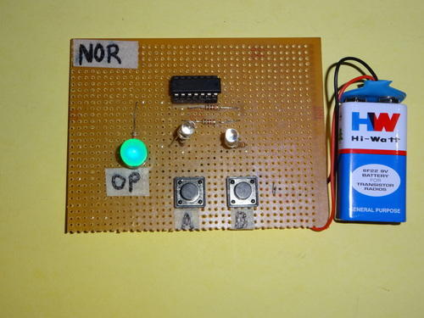
PROJECT REPORT - PHYSICS BY - ADITYA CLASS XII-B ROLL NO. -
NOR GATE

Slide 2
ACKNOWLEDGEMENT
I would like to express my special thanks of gratitude to my teacher (Mrs.Vandana) as well as our principal who gave me the golden opportunity to do this wonderful project , which also helped me in doing a lot of Research and i came to know about so many new things I am really thankful to them. Secondly i would also like to thank my parents and friends who helped me a lot in finalizing this project within the limited time frame.

Slide 3
CONTENTS
INTRODUCTION
THEORY
THE NOR GATE
EQUIPMENT USED
BIBLIOGRAPHY

Slide 4
INTRODUCTION
In electronics, a logic gate is an idealized or physical device implementing a Boolean function; that is, it performs a logical operation on one or more binary inputs and produces a single binary output. Depending on the context, the term may refer to an ideal logic gate, one that has for instance zero rise time and unlimited fan-out, or it may refer to a non-ideal physical device (see Ideal and real op-amps for comparison).
Logic gates are primarily implemented using diodes or transistors acting as electronic switches, but can also be constructed using vacuum tubes, electromagnetic relays (relay logic), fluidic logic, pneumatic logic, optics, molecules, or even mechanical elements. With amplification, logic gates can be cascaded in the same way that Boolean functions can be composed, allowing the construction of a physical model of all of Boolean logic, and therefore, all of the algorithms and mathematics that can be described with Boolean logic.
Logic circuits include such devices as multiplexers, registers, arithmetic logic units (ALUs), and computer memory, all the way up through complete microprocessors, which may contain more than 100 million gates. In modern practice, most gates are made from field-effect transistors (FETs), particularly metal–oxide–semiconductor field-effect transistors (MOSFETs).
Compound logic gates AND-OR-Invert (AOI) and OR-AND-Invert (OAI) are often employed in circuit design because their construction using MOSFETs is simpler and more efficient than the sum of the individual gates.
In reversible logic, Toffoli gates are used.

Slide 5
NOR GATE
The NOR gate is a digital logic gate that implements logical NOR - it behaves according to the truth table to the right. A HIGH output (1) results if both the inputs to the gate are LOW (0); if one or both input is HIGH (1), a LOW output (0) results. NOR is the result of the negation of the OR operator. It can also be seen as an AND gate with all the inputs inverted. NOR is a functionally complete operation—NOR gates can be combined to generate any other logical function. it shares this property with the NAND gate. By contrast, the OR operator is monotonic as it can only change LOW to HIGH but not vice versa.
In most, but not all, circuit implementations, the negation comes for free—including CMOS and TTL. In such logic families, OR is the more complicated operation; it may use a NOR followed by a NOT. A significant exception is some forms of the domino logic family.
The original Apollo Guidance Computer used 4,100 integrated circuits (IC), each one containing only a single 3-input NOR gate.

Slide 6
Equipment used
BATTERY
RESISTOR
LED LIGHTS
PRINTED CIRCUIT BOARD
PUSH BUTTON
TRANSISTOR
DIODE
INTEGRATED CIRCUIT

Slide 7



SYMBOLS There are three symbols for NOR gates: the American (ANSI or 'military') symbol and the IEC ('European' or 'rectangular') symbol, as well as the deprecated DIN symbol. For more information see Logic Gate Symbols. The ANSI symbol for the NOR gate is a standard OR gate with an inversion bubble connected.
MIL/ANSI Symbol IEC Symbol DIN Symbol

Slide 8
BATTERY
An electric battery is a device consisting of one or more electrochemical cells with external connections provided to power electrical devices such as flashlights, smartphones, and electric cars.^{[1]} When a battery is supplying electric power, its positive terminal is the cathode and its negative terminal is the anode.^{[2]} The terminal marked negative is the source of electrons that when connected to an external circuit will flow and deliver energy to an external device. When a battery is connected to an external circuit, electrolytes are able to move as ions within, allowing the chemical reactions to be completed at the separate terminals and so deliver energy to the external circuit. It is the movement of those ions within the battery which allows current to flow out of the battery to perform work.^{[3]} Historically the term "battery" specifically referred to a device composed of multiple cells, however the usage has evolved additionally to include devices composed of a single cell.^{[4]}
Primary (single-use or "disposable") batteries are used once and discarded; the electrode materials are irreversibly changed during discharge. Common examples are the alkaline battery used for flashlights and a multitude of portable electronic devices. Secondary (rechargeable) batteries can be discharged and recharged multiple times using an applied electric current; the original composition of the electrodes can be restored by reverse current. Examples include the lead-acid batteries used in vehicles and lithium-ion batteries used for portable electronics such as laptops and smartphones.
Batteries come in many shapes and sizes, from miniature cells used to power hearing aids and wristwatches to small, thin cells used in smartphones, to large lead acid batteries used in cars and trucks, and at the largest extreme, huge battery banks the size of rooms that provide standby or emergency power for telephone exchanges and computer data centers.
According to a 2005 estimate, the worldwide battery industry generates US$48 billion in sales each year,^{[5]} with 6% annual growth.
Batteries have much lower specific energy (energy per unit mass) than common fuels such as gasoline. In automobiles, this is somewhat offset by the higher efficiency of electric motors in producing mechanical work, compared to combustion engines.

Slide 9
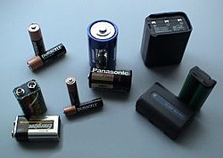
Type - Power source Working principle -Electrochemical reactions, Electromotive force First production - 1800s
Various cells and batteries (top-left to bottom-right): two AA, one D, one handheld ham radiobattery, two 9-volt (PP3), two AAA, one C, one camcorder battery, one cordless phone battery

Slide 10
LED LIGHTS
A LED lamp or LED light bulb is an electric light for use in light fixtures that produces light using light-emitting diode (LED). LED lamps have a lifespan and electrical efficiency which are several times greater than incandescent lamps, and are significantly more efficient than most fluorescent lamps,^{[1][2][3]} with some LED chips able to emit up to 303 lumens per watt (as claimed by Cree and some other LED manufacturers).However, an LED lamp will never be as efficient as the LED chips it uses, due to losses from the LED driver that is required to use LEDs on mains voltage (or on the mains supply). The most efficient commercially LED lamps have efficiencies of 200 lumens per watt (lm/w).Commercially available LED chips have efficiencies of over 220 lm/w The LED lamp market is projected to grow by more than twelve-fold over the next decade, from $2 billion in the beginning of 2014 to $25 billion in 2023, a compound annual growth rate (CAGR) of 25%.As of 2016, LEDs use only about 10% of the energy an incandescent lamp requires.
Similar to incandescent lamps and unlike most fluorescent lamps (e.g. tubes and compact fluorescent lamps or CFLs), LEDs come to full brightness without need for a warm-up time; the life of fluorescent lighting is also reduced by frequent switching on and off. The initial cost of LED is usually higher. Degradation of LED dye and packaging materials reduces light output to some extent over time.
Some LED lamps are made to be a directly compatible drop-in replacement for incandescent or fluorescent lamps. An LED lamp packaging may show the lumen output, power consumption in watts, color temperature in kelvins or description (e.g. "warm white", "cool white" or "daylight"), operating temperature range, and sometimes the equivalent wattage of an incandescent lamp of similar luminous output.
Most LEDs do not emit light in all directions, and their directional characteristics affect the design of lamps, although omnidirectional lamps which radiate light over a 360° angle are becoming more common. The light output of single LED is less than that of incandescent and compact fluorescent lamps; in most applications multiple LEDs are used to form a lamp, although high-power versions are becoming available.
LEDs, as their name suggests, operate as diodes and run on direct current (DC), whereas mains current is alternating current(AC) and usually at much higher voltage than the LED can accept. Although low voltage LED lamps are available, LED lamps can contain a circuit for converting the mains AC into DC at the correct voltage. These circuits contain rectifiers, capacitors and may have other active electronic components, which may or may not permit the lamp to be dimmed.

Slide 11
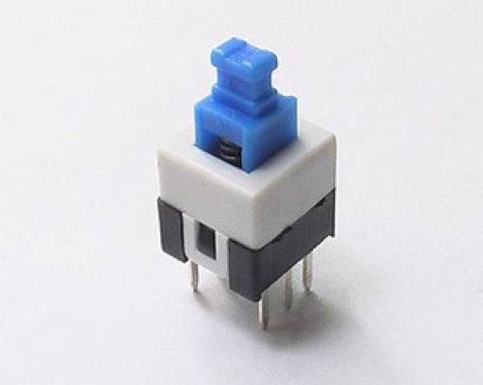
PUSH BUTTON push-button (also spelled pushbutton) or simply button is a simple switch mechanism for controlling some aspect of a machine or a process. Buttons are typically made out of hard material, usually plastic or metal. The surface is usually flat or shaped to accommodate the human finger or hand, so as to be easily depressed or pushed. Buttons are most often biased switches, although many un-biased buttons (due to their physical nature) still require a spring to return to their un-pushed state. Terms for the "pushing" of a button include pressing, depressing, mashing, hitting, and punching.
The "push-button" has been utilized in calculators, push-button telephones, kitchen appliances, and various other mechanical and electronic devices, home and commercial.

Slide 12
Bibliography
Theory - NCERT
WIKIPEDIA
GOOGLE
SCRIBID
Images - GOOGLE

Slide 13
THANK YOU BY – ADITYA CLASS – XII – B ROLL NO.

